Slide 1
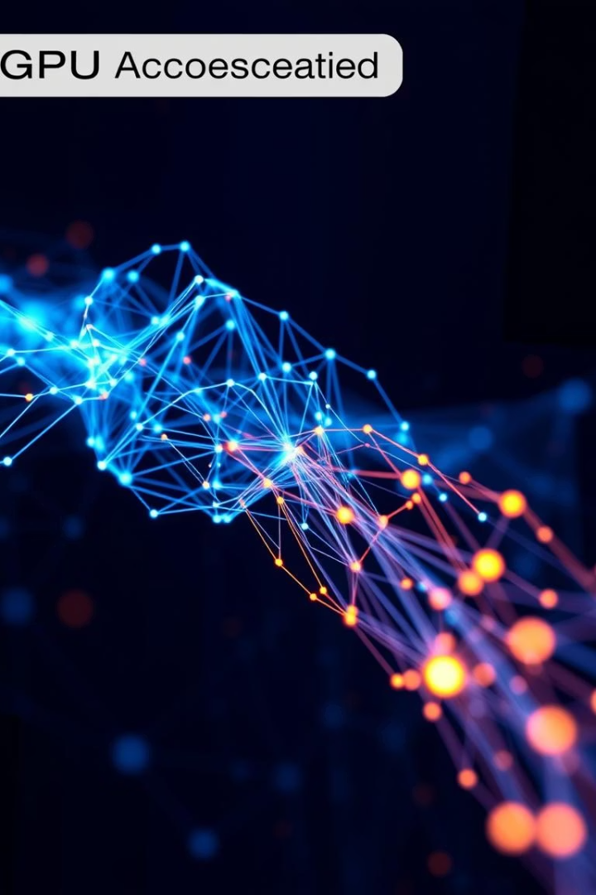
High Performance Computing with GPUs
This presentation explores GPU acceleration for neural networks, specifically focusing on MNIST digit classification. We'll examine how different implementations—from sequential CPU code to optimized GPU solutions using CUDA and Tensor Cores—affect performance and accuracy.

Slide 2
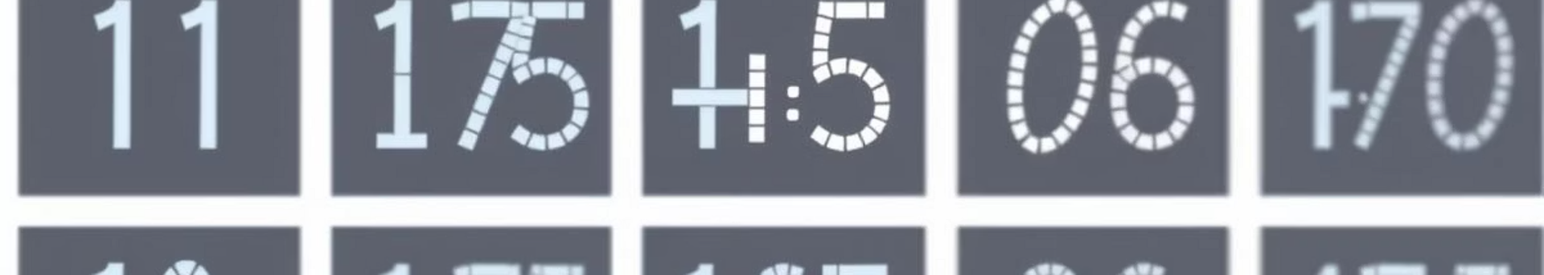
Project Overview & Neural Network Architecture
Project Goal
Motivation
Network Structure
Accelerate neural network training for MNIST digit classification using GPU-based computation
Leverage GPU's parallel processing capabilities for matrix operations central to neural networks
Input: 784 neurons (28x28 flattened images), Hidden: 128 neurons with ReLU, Output: 10 neurons with Softmax
Our neural network architecture is deliberately simple to focus on acceleration techniques rather than model complexity. The network processes grayscale images of handwritten digits, classifying them into one of ten possible digits (0-9).

Slide 3


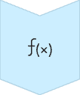


Sequential Implementation (Baseline)
Matrix Multiplication
Performed using nested loops on CPU
Activation Functions
ReLU and Softmax computed element-wise
Gradient Computation
Done with nested loops sequentially
Weight Updates
Handled sequentially without parallelization
Version 1 serves as our baseline implementation, executing all neural network operations sequentially on the CPU. This approach processes each computation one after another without any parallelism, providing a reference point for measuring performance improvements in subsequent versions.

Slide 4
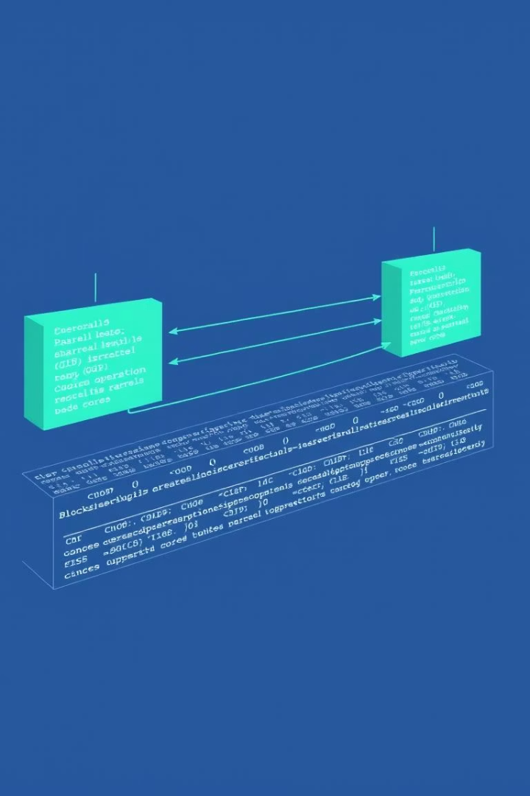
Naive CUDA Implementation
Component
V1 (Sequential)
V2 (Naive GPU with CUDA)
Matrix Multiplication
Loops over rows and columns on CPU
Separate CUDA kernels using grid-strided parallelism
Activation Functions
ReLU and Softmax on CPU
relu_kernel and softmax_kernel in CUDA
Gradient Computation
Done with nested loops
Parallel CUDA kernels for gradient computation
Weight Updates
Sequential updates
CUDA kernels for weight updates
Version 2 moves computation to the GPU using CUDA. While all operations are parallelized across GPU cores, this implementation still faces significant bottlenecks, particularly in memory transfers between CPU and GPU. Basic parallelization alone doesn't guarantee performance improvements.

Slide 5
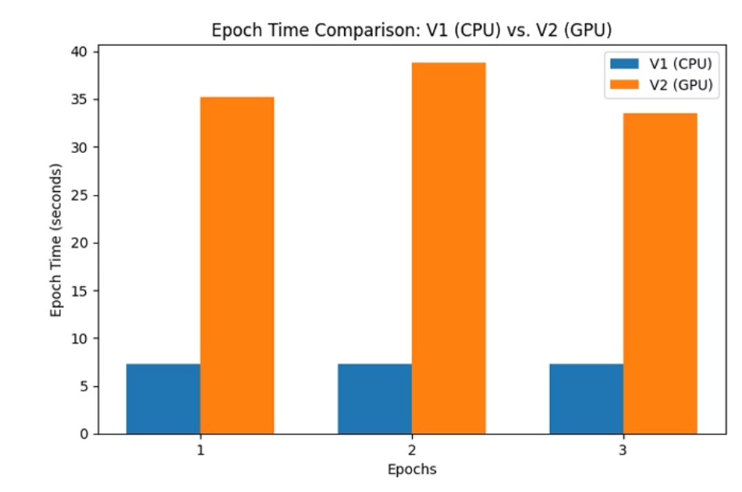
Initial Results & Observations
Surprisingly, our naive GPU implementation is actually slower than the CPU version. The graph reveals why: data transfer times between host and device overshadow the actual GPU execution times. Even though computations are faster on the GPU, the overhead of moving data back and forth negates these gains.
This highlights a critical lesson in GPU programming: memory management is often more important than computational parallelism.

Slide 6
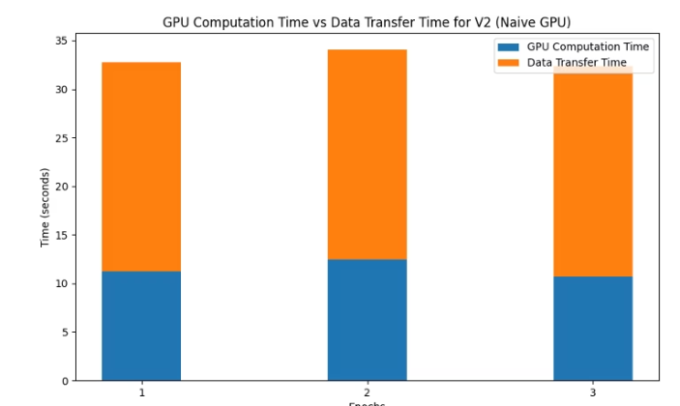




Optimized CUDA Implementation
Kernel Fusion
Combined operations to reduce kernel launches
Shared Memory Tiling
Reduced global memory access latency
CUDA Streams
Overlapped data transfer and computation
Pinned Memory
Faster host-device transfers
Version 3 addresses the bottlenecks identified in V2 through sophisticated optimization techniques. By reducing memory transfer overhead and improving computational efficiency, these optimizations aim to unlock the true potential of GPU acceleration.

Slide 7
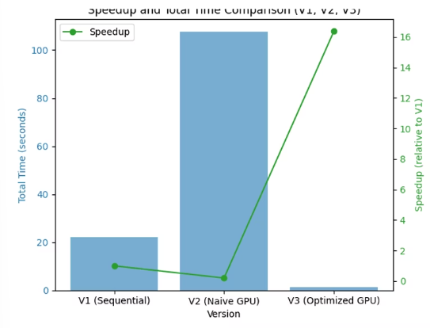
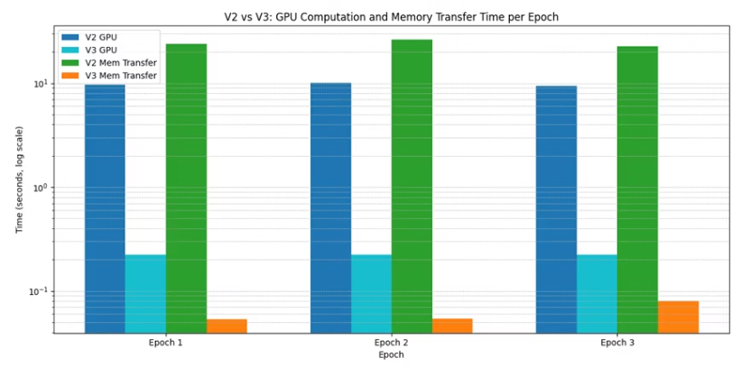
Optimized Implementation Results
The optimized implementation achieves a remarkable 16x speedup over the baseline. This dramatic improvement comes from addressing memory bottlenecks and optimizing GPU execution patterns. While there's a slight accuracy trade-off in the first epoch, the final model maintains excellent classification performance.

Slide 8
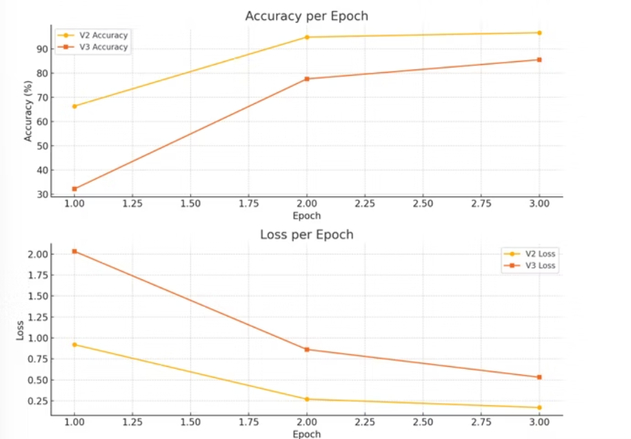
Tradeoffs:
This does come at the price of some accuracy (mainly in Epoch 1) though and an increase in loss.

Slide 9








Tensor Cores & Further Optimization
cuBLAS Integration
FP16 Precision
Leveraging optimized libraries for matrix operations
Half-precision floating point for faster computation
Speed-Accuracy Trade-off
Specialized Hardware
Dedicated matrix multiplication units on modern GPUs
Managing precision reduction while maintaining results

Slide 10
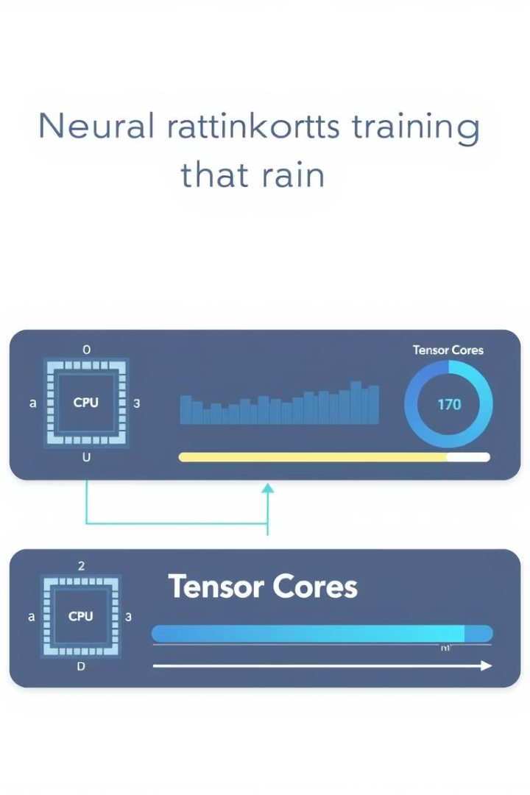
Key Learnings & Conclusion
Memory Management is Critical
Efficient memory handling (pinned/shared memory, reuse) is essential for GPU performance, often more important than computational optimizations.
Optimization Techniques Matter
Tiling, kernel fusion, CUDA streams, and batch processing significantly improve performance by reducing overhead and increasing GPU utilization.
Hardware-Software Integration
Specialized hardware like Tensor Cores, when properly leveraged with appropriate software techniques, provides substantial acceleration for neural network training.
This project successfully demonstrated how GPU acceleration can dramatically improve neural network training efficiency.

Slide 11
Thankyou!
by
I221249 - Atif Ibrahim
I220827 - Muhammad Ali
I220902 - Hussain Ali Zaidi

